Slide 1
Apache HBase

Slide 2
HBase in Hadoop Eco System
AMBARI
HIVE
PIG
MAHOUT
SQOOP
MAP REDUCE
OOZIE
ZOOKEEPER
HBASE
HCATALOG
FLUME
HDFS

Slide 3
HBASE
HBase is an open source distributed, sparse,
multidimensional sorted map modelled
After Google’s Big Table
Map -> Associates keys to values
Sorted -> Ordered by key (efficient look-ups)
Multidimensional -> Key is formed by several values
Persistent -> Once written, it is there until removed
Distributed -> Stored across different nodes
Sparse -> Many (most) values are not defined

Slide 4
When to Use HBASE
• Lots of data
100s of Gigabytes upto Petabytes
•High write throughput
1000s /second (per second)

Slide 5
When to Use HBASE
• Storing relationships between the element is not important.
• The data is not structured or the structure is changing with time.
• Constraints and Validation logic are required to be implemented at Database Level
• Dealing with growing lists of elements like Twitter and Facebook post, Blogs, server logs etc.

Slide 6
When Not to Use HBASE
• Complex transaction need to handled
• Joins must be handled at database level
• Validation must be handled at database level
• Dealing with GB of data

Slide 7
HBASE vs RDBMS
HBASE | RDBMS
Column Oriented | Row Oriented
Flexible Schema, Create column on the fly | Fixed Schema
Good for Sparse Tables | Good for Structured Tables
Not providing SQL based access | SQL query access
Wide Tables | Narrow Tables
Joins using MR – Not optimized | Optimized for joins(Faster)
Tight Integration with MR | No MR
De Normalized Data | Normalized Data
Horizontally Scalable | Hard to Shard and Scale
Consistent | Consistent

Slide 8
HBase Built on Hadoop
Hadoop provides
•Fault tolerance
•Scalability
•Batch Processing with Map reduce
•HDFS lacks Random read/write capabilities
•HBase = HDFS + Random read/writes
•HBase uses HDFS for storage but adds random read and write by appending writes to a logs and occasionally merging those with HDFS files

Slide 9
Data Model
•Every row has a row key
•Rows are stored by row key for fast lookups
•A table may have 1 or more column families
•Common to have a small number of column families
•A column family can have number of columns
•Each row has a timestamp
•Multiple versions of a row can exist

Slide 10
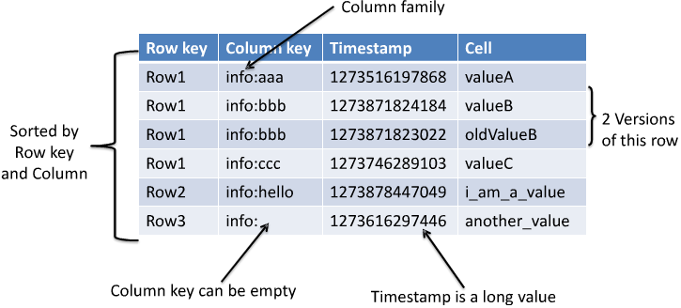
Table Format
Table is Distributed Sorted Map
Row Key + Column Key + Timestamp -> Value

Slide 11
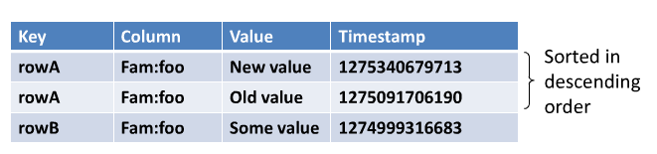
Versions of Data
• Keeps 3 versions of a row by Default
• Sorted by their timestamp (descending order)

Slide 12
Shell Commands
•list
•Lists all user tables in HBase
•describe <table name>
•Returns the structure of the table

Slide 13
Create
create 't1', {NAME => 'cf1', VERSIONS => 5}
create 't1', {NAME => 'cf1'}, {NAME => 'cf2'}, {NAME => 'cf3'}
create 't1', 'cf1', 'cf2', 'cf3'

Slide 14
Get & Put
get 't1', 'r1'
get 't1', 'r1', {TIMERANGE => [ts1, ts2]}
get 't1', 'r1', {COLUMN => 'c1'}
get 't1', 'r1', {COLUMN => ['c1', 'c2', 'c3']}
put 't1', 'r1', 'c1', 'value', ts1

Slide 15
Scan
scan 't1'
scan 't1', {COLUMNS => ''}
scan 't1', {COLUMNS => ['c1', 'c2'], LIMIT => 10, STARTROW => 'xyz'}
scan 't1', {COLUMNS => 'c1', TIMERANGE => [1303668804, 1303668904]}

Slide 16
Delete
Deleting columns in a row
delete ‘table_name’, ‘row_key’, ‘column_name’,’timestamp’
Delete an entire row
deleteall ‘table_name’, ‘row_key’

Slide 17
Removing Table
Disable ‘<TableName>’
Drop ‘<>’

Slide 18
HBase Deamons
HMaster
HRegionServer

Slide 19
Terms
Region
A subset of a table’s rows , like a partition
RegionServer
Serves data for reads and writes
Master
Responsible for coordinating the slaves (HRegionServer)
Assigns regions, detects failures of HregionServers and controls some admin functions

Slide 20
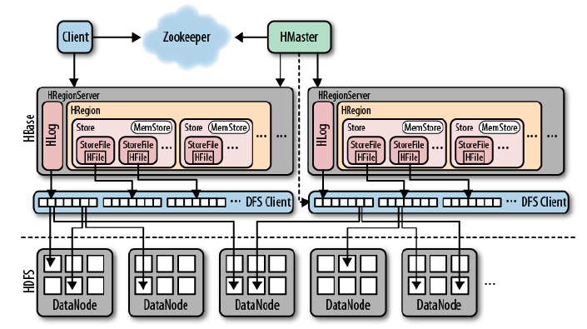
HBase High Level Architecture

Slide 21
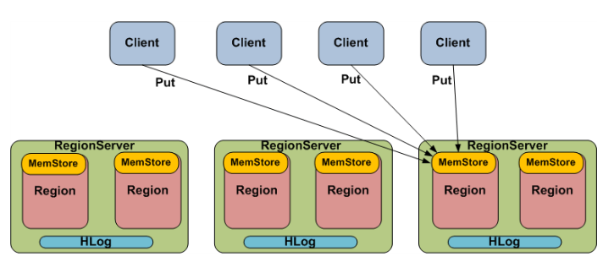
Distribution Of Data
Sequential RowKeys will go the same region

Slide 22
Create Table in HBase
ZooKeeper
Issue create Statement Master
Client
HMaster
RegionServer
RegionServer

Slide 23
Data Storage
Data is written to the Region’s Memstore
The Hlog is required for crash recovery if the MeMStore is lost
When the Memstore gets to a certain size, it will flush to an immutable file (Store file)
Eventually these store files will be aggreagted and cleaned up during a compaction

Slide 24
Region Splits
When a Region grows to a certain size, the RegionServer will split the Region:
A Region reaches 256MB
RegionServer splits the Region into 2 roughly equal Regions
RegionServer updates META table
RegionServer informs Master of the split
Master assigns the new Region to a RegionServer
Region Size is configurable.

Slide 25
Hands On
Hands On Exercise

Slide 26
Any Questions??
Thank You!!!

